Slide 1
Evaluating the Helpfulness of Linked Entities to Readers
Yamada I, Ito T, et al

Slide 2
Contents
Introduction
Features
Experiments
Discussion

Slide 3
Contents
Introduction
Features
Experiments
Discussion

Slide 4
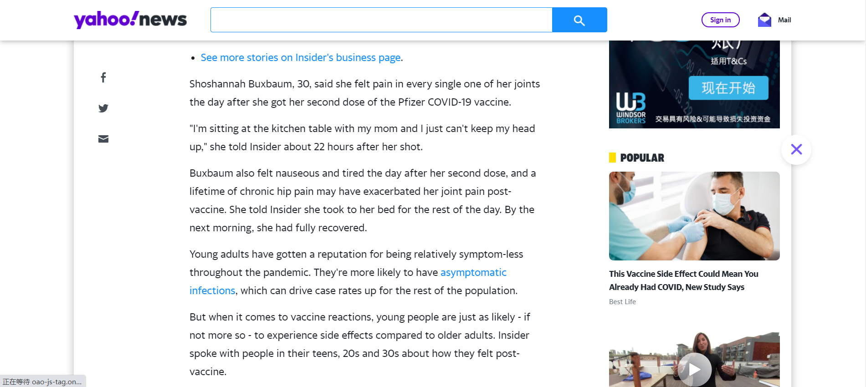
Yahoo News

Slide 5
Entity Linking
Entity Linking consists of two subtasks: Named Entity Recognition (detecting mentions) and Named Entity Disambiguation (linking the named entity to a knowledge base).
The short highway in New South Wales and the Australian Capital Territory in Australia, it is part of Sydney-Canberra National Highway link.

Slide 6
Entity Linking
Question: What are the entities?
The short highway in New South Wales and the Australian Capital Territory in Australia, it is part of Sydney-Canberra National Highway link.

Slide 7
Entity Linking
Problems:
Is this mention an entity?
What about nested entities?
Is it helpful to link this entity?
The [short] [highway] in [New [South] [Wales]] and the [[Australian] Capital [Territory]] in [Australia], it is part of [[Sydney]-[Canberra] [National [Highway]]] link.

Slide 8
Entity Linking
Problems:
Is this mention an entity?
What about nested entities?
Is it helpful to link this entity?
The [short] [highway] in [New [South] [Wales]] and the [[Australian] Capital [Territory]] in [Australia], it is part of [[Sydney]-[Canberra] [National [Highway]]] link.

Slide 9
Two Papers
Yamada I, Ito T, Usami S, et al. Evaluating the helpfulness of linked entities to readers[C]//Proceedings of the 25th ACM conference on Hypertext and social media. 2014: 169-178.
Yamada I, Ito T, Takeda H, et al. Linkify: enhancing text reading experience by detecting and linking helpful entities to users[J]. IEEE Intelligent Systems, 2018, 33(5): 37-46.

Slide 10
Contents
Introduction
Features
Experiments
Discussion

Slide 11

Notation and Task Definition
$D$: A document to be analyzed
$KB$: A knowledge base
$M$: A set of entity mentions in $D$
$m∈M$: An entity mention in $M$
$E$: A set of KB entities in D
$e∈E$: An entity in$E$

Slide 12
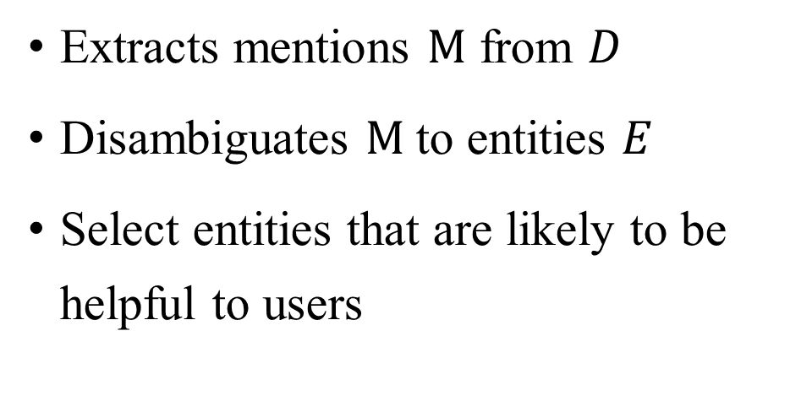
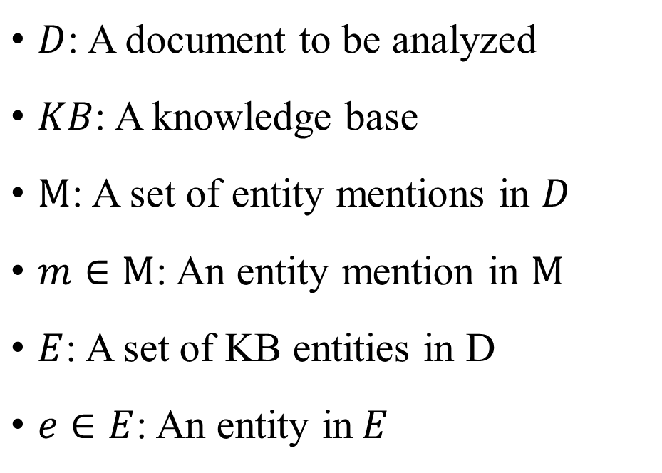
Notation and Task Definition
$D$: A document to be analyzed
$KB$: A knowledge base
$M$: A set of entity mentions in $D$
$m∈M$: An entity mention in $M$
$E$: A set of KB entities in D
$e∈E$: An entity in$E$
Extracts mentions $M$ from $D$
Disambiguates $M$ to entities $E$
Select entities that are likely to be helpful to users

Slide 13
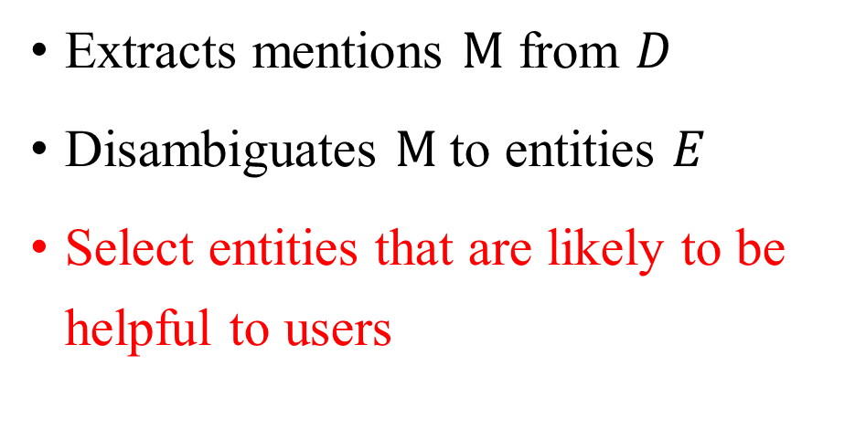
Notation and Task Definition
$D$: A document to be analyzed
$KB$: A knowledge base
$M$: A set of entity mentions in $D$
$m∈M$: An entity mention in $M$
$E$: A set of KB entities in D
$e∈E$: An entity in$E$
Extracts mentions $M$ from $D$
Disambiguates $M$ to entities $E$
Select entities that are likely to be helpful to users

Slide 14
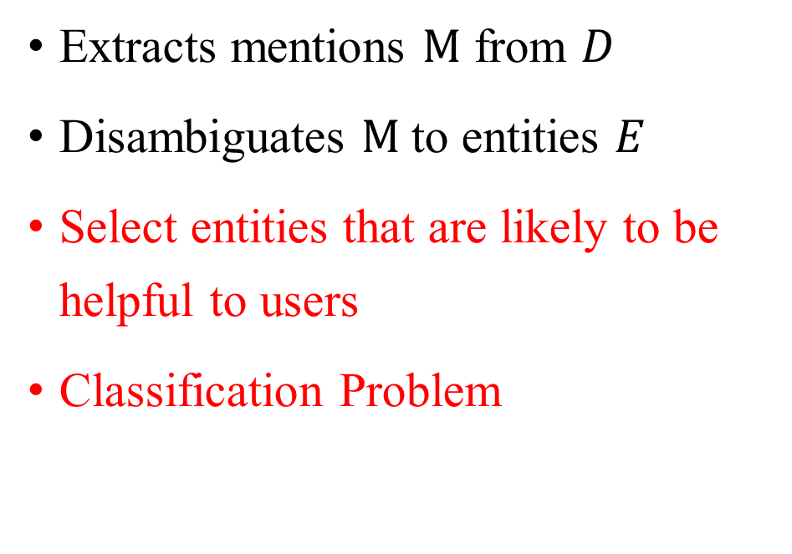
Notation and Task Definition
$D$: A document to be analyzed
$KB$: A knowledge base
$M$: A set of entity mentions in $D$
$m∈M$: An entity mention in $M$
$E$: A set of KB entities in D
$e∈E$: An entity in$E$
Extracts mentions $M$ from $D$
Disambiguates $M$ to entities $E$
Select entities that are likely to be helpful to users
Classification Problem

Slide 15
Features
Link Probability Feature
Entity Feature
Entity Class Feature
Topical Coherence Feature
Textual Feature
Mention Occurrence Feature

Slide 16
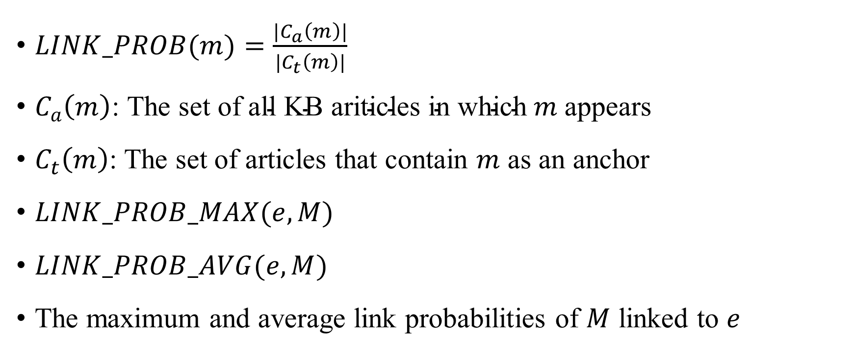
Link Probability Feature
$LINK_PROB(m)=\frac{{|C}_{a}\left(m\right)|}{|C_{t}\left(m\right)|}$
$C_{a}\left(m\right)\text{: }\text{The} \text{set} \text{of} \text{all} \text{KB} \text{ariticles} \text{in} \text{which} m$appears
$C_{t}\left(m\right)$: The set of articles that contain $m$ as an anchor
$LINK_PROB_MAX(e, M)$
$LINK_PROB_AVG(e, M)$
The maximum and average link probabilities of $M$ linked to $e$

Slide 17
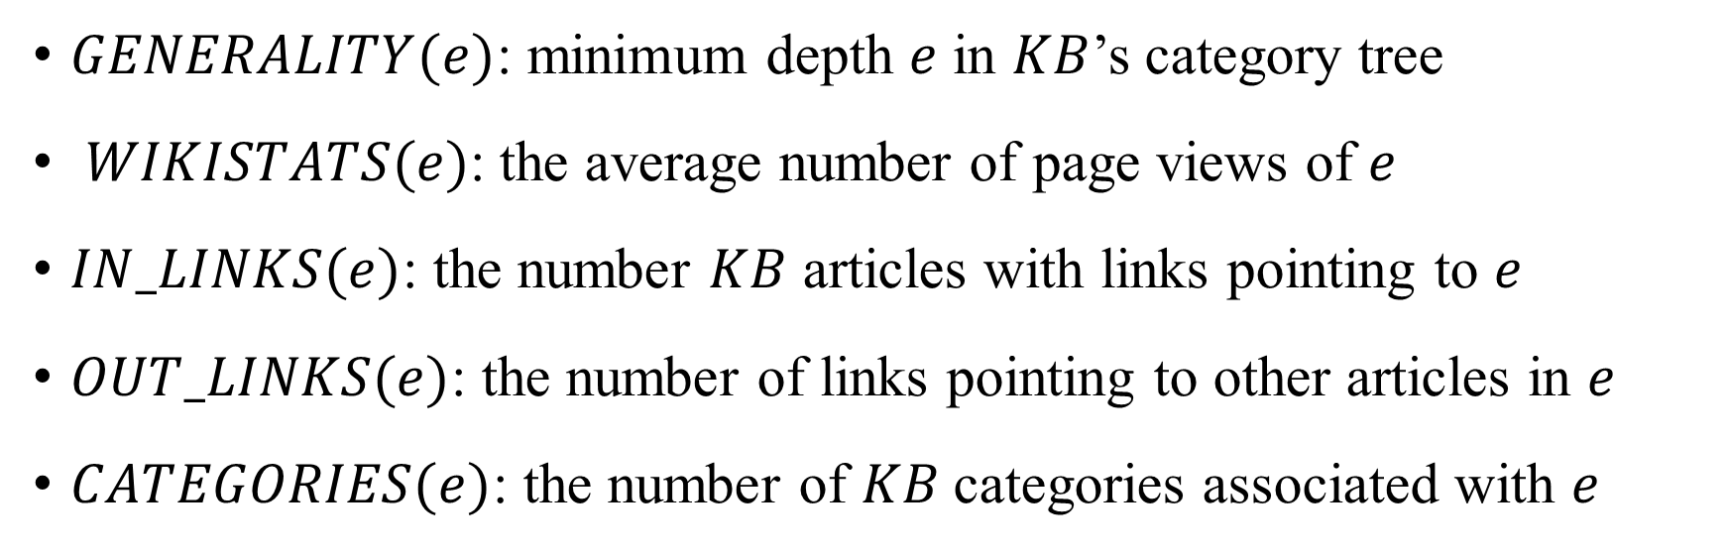
Entity Feature
$GENERALITY(e)$: minimum depth $e$ in $KB$’s category tree
$WIKISTATS(e)$: the average number of page views of $e$
$IN_LINKS(e)$: the number $KB$ articles with links pointing to $e$
$OUT_LINKS(e)$: the number of links pointing to other articles in $e$
$CATEGORIES(e)$: the number of $KB$categories associated with $e$

Slide 18
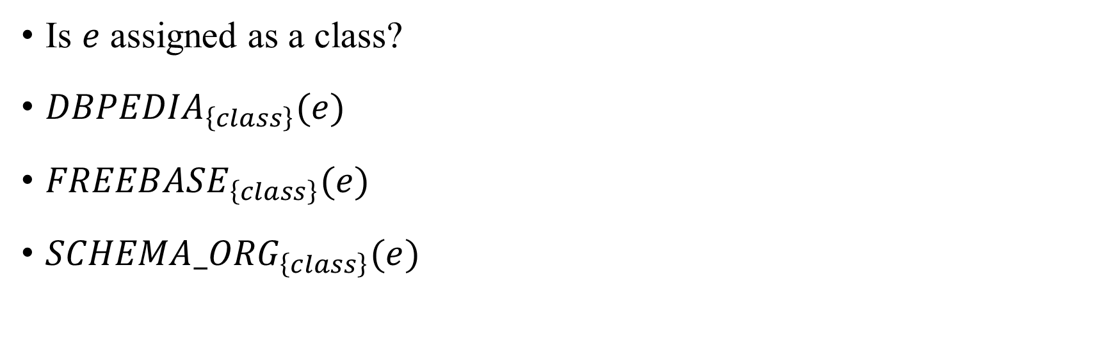
Entity Class Feature
Is $e$ assigned as a class?
${DBPEDIA}_{\left\{class\right\}}(e)$
${FREEBASE}_{\left\{class\right\}}(e)$
${SCHEMA_ORG}_{\left\{class\right\}}(e)$

Slide 19
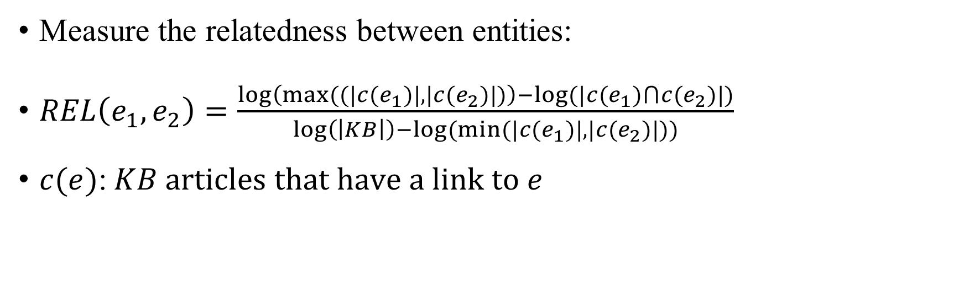
Topical Coherence Feature
Measure the relatedness between entities:
$REL\left(e_{1},e_{2}\right)=\frac{\log\left(max((|c(e_{1})|,|c(e_{2})|)\right)−log⁡(|c(e_{1})⋂c(e_{2})|)}{\log\left(\left|KB\right|\right)−log⁡(min⁡(|c(e_{1})|,|c(e_{2})|))}$
$c(e)$:$KB articles that have a link to e$

Slide 20
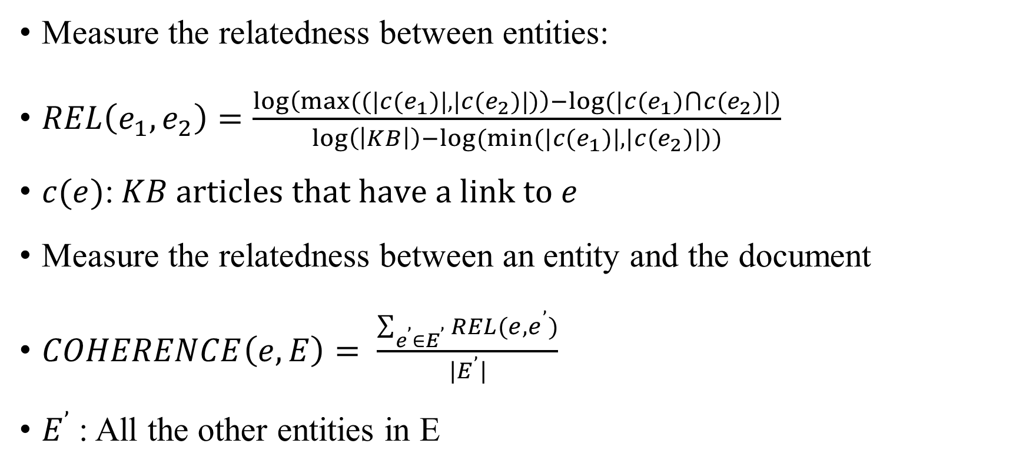
Topical Coherence Feature
Measure the relatedness between entities:
$REL\left(e_{1},e_{2}\right)=\frac{\log\left(max((|c(e_{1})|,|c(e_{2})|)\right)−log⁡(|c(e_{1})⋂c(e_{2})|)}{\log\left(\left|KB\right|\right)−log⁡(min⁡(|c(e_{1})|,|c(e_{2})|))}$
$c(e)$:$KB articles that have a link to e$
Measure the relatedness between an entity and the document
$COHERENCE\left(e,E\right)= \frac{\sum_{{e^{’}∈E}^{’}}{REL(e,e^{’})}}{|E^{’}|}$
$E^{’}$: All the other entities in E

Slide 21
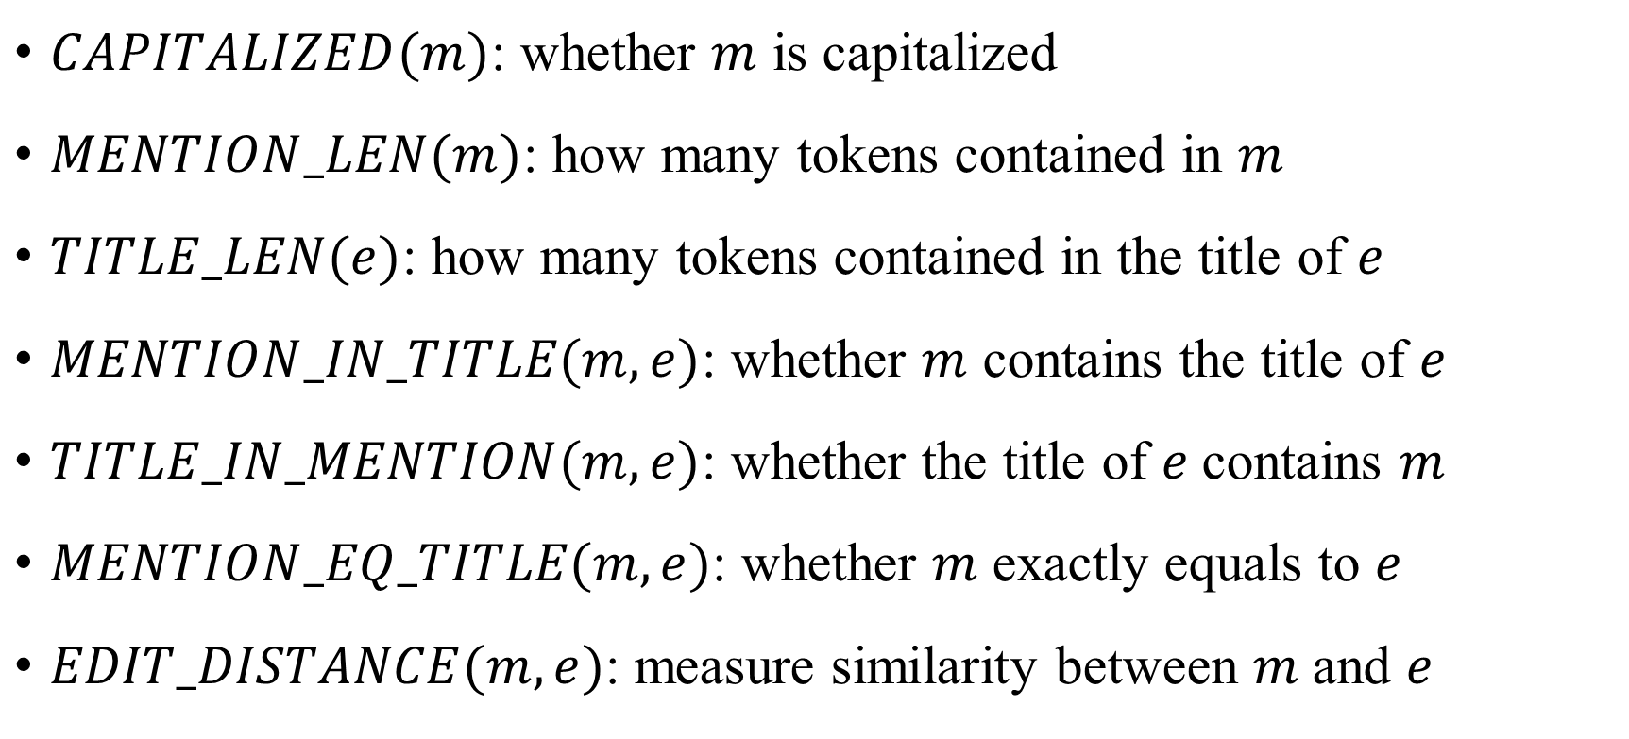
Textual Feature
$CAPITALIZED(m)$: whether $m$ is capitalized
$MENTION_LEN(m)$: how many tokens contained in $m$
$TITLE_LEN(e)$: how many tokens contained in the title of $e$
$MENTION_IN_TITLE(m, e)$: whether $m$ contains the title of $e$
$TITLE_IN_MENTION(m, e)$: whether the title of 𝑒 contains 𝑚
$MENTION_EQ_TITLE(m, e)$: whether 𝑚 exactly equals to $e$
$EDIT_DISTANCE(m, e)$: measure similarity between 𝑚 and $e$

Slide 22

Mention Occurrence Feature
$SPREAD(m, D)$: the number of tokens between the first occurrence and the last occurrence of $m$ in $D$
$FREQUENCY(m, D)$: the number of times that $m$ occurs in $D$

Slide 23
All the Features

Slide 24
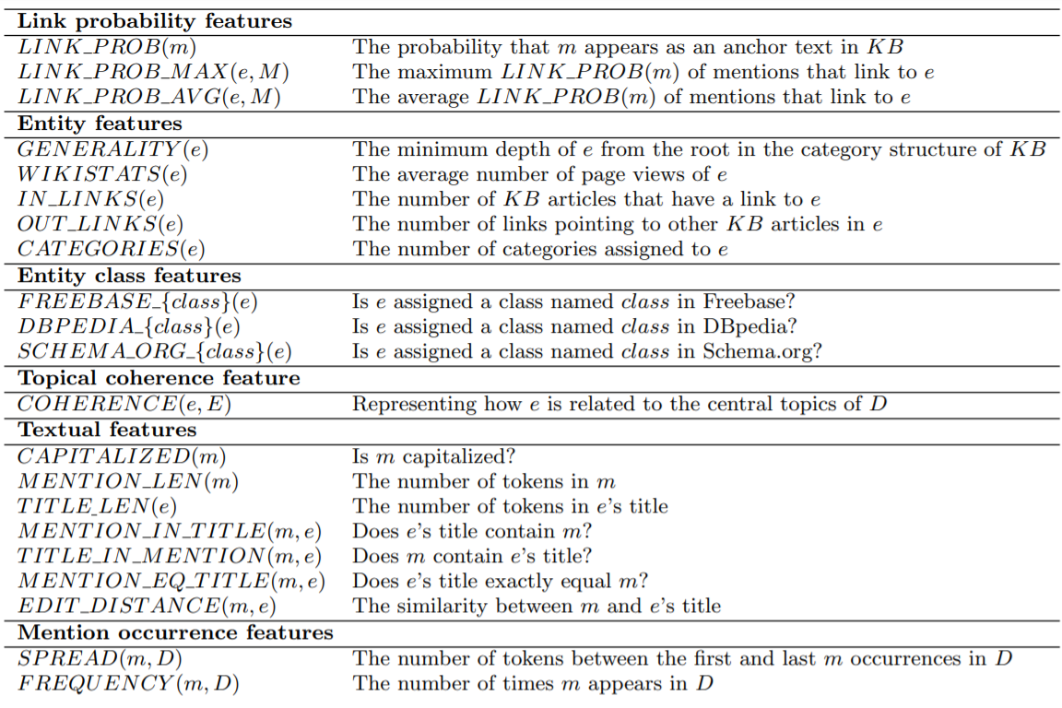
All the Features

Slide 25
Contents
Introduction
Features
Experiments
Discussion

Slide 26
Dataset
IITB EL dataset
Crowd-sourcing Service
Question: “Do you think converting the highlighted keyword into a link is sufficiently helpful to readers of this document and could it improve the readers’ overall user experience?”
Very helpful; Helpful; Rarely helpful; Not helpful

Slide 27
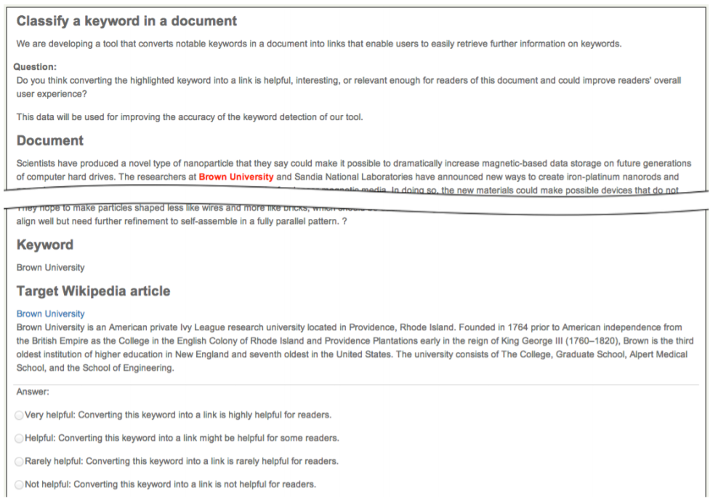

Slide 28
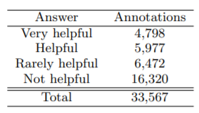
Dataset

Slide 29
Dataset

Slide 30
Dataset
72.8% of annotations received the same binary judgments from all three annotators

Slide 31
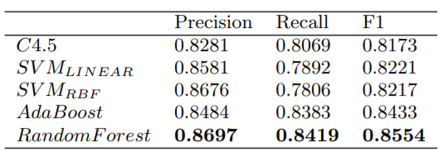
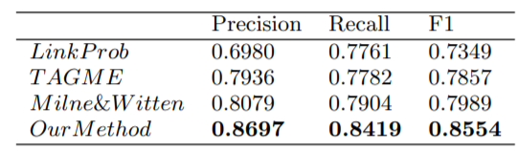
Results

Slide 32
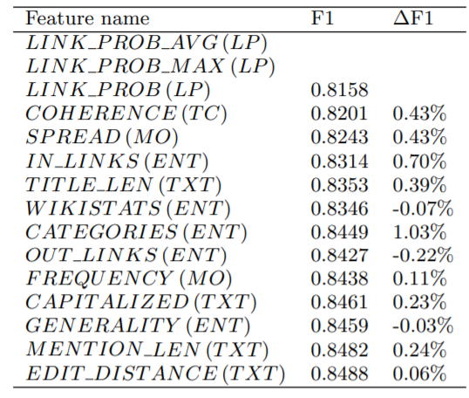
Feature Analysis

Slide 33
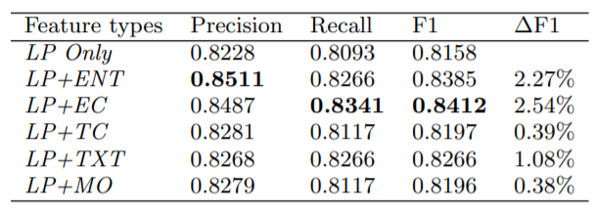
Feature Analysis

Slide 34
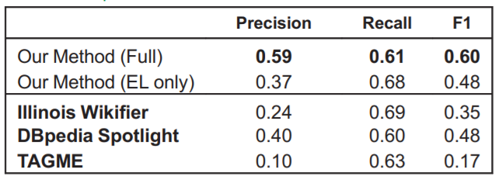
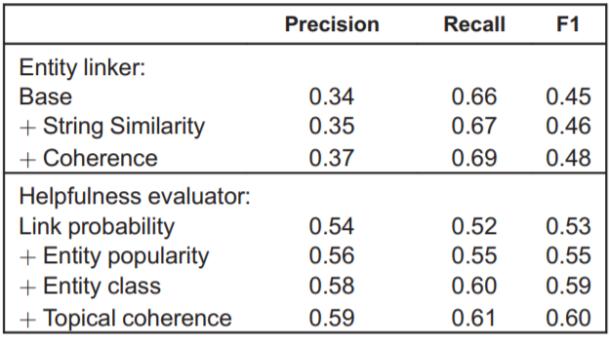
The Second Paper

Slide 35
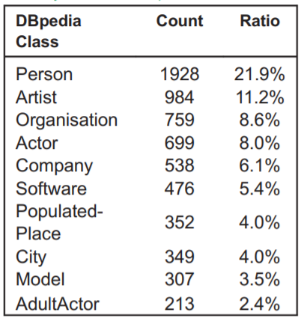
Click Log
Top 10 common entity types selected by user

Slide 36
Contents
Introduction
Features
Experiments
Discussion

Slide 37
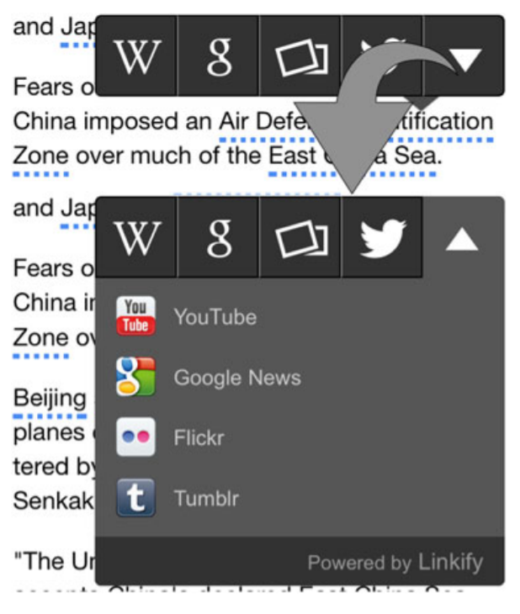
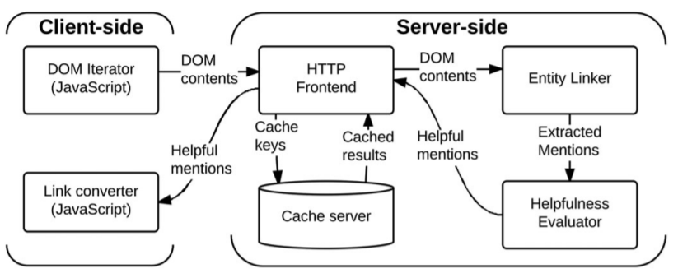
Linkify

Slide 38
Discussion

Slide 39
Q&A

